Slide 1
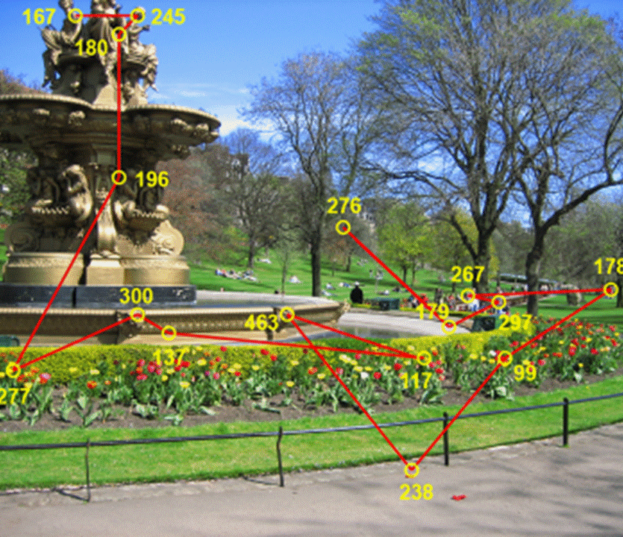
Eye-movements

Slide 2
Why do we move our eyes?
- Image stabilization
Information acquisition
To bring objects of interest onto high acuity region in fovea.

Slide 3
The Big Picture

Slide 4
The Early Visual Encoding

Slide 5
What does the retina do for us?
Encode the retinal image in space, time and wavelength
Amplify edges relative to uniform areas of the retinal image
Provide a wide field of view and high spatial resolution
Adjust for changes in ambient light level

Slide 6
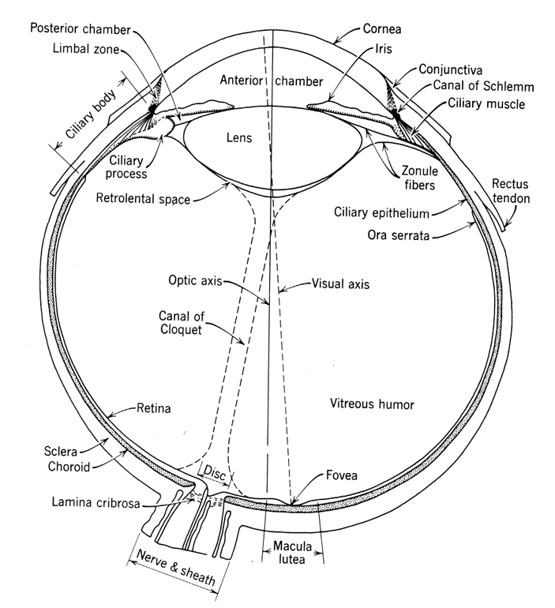

Slide 7
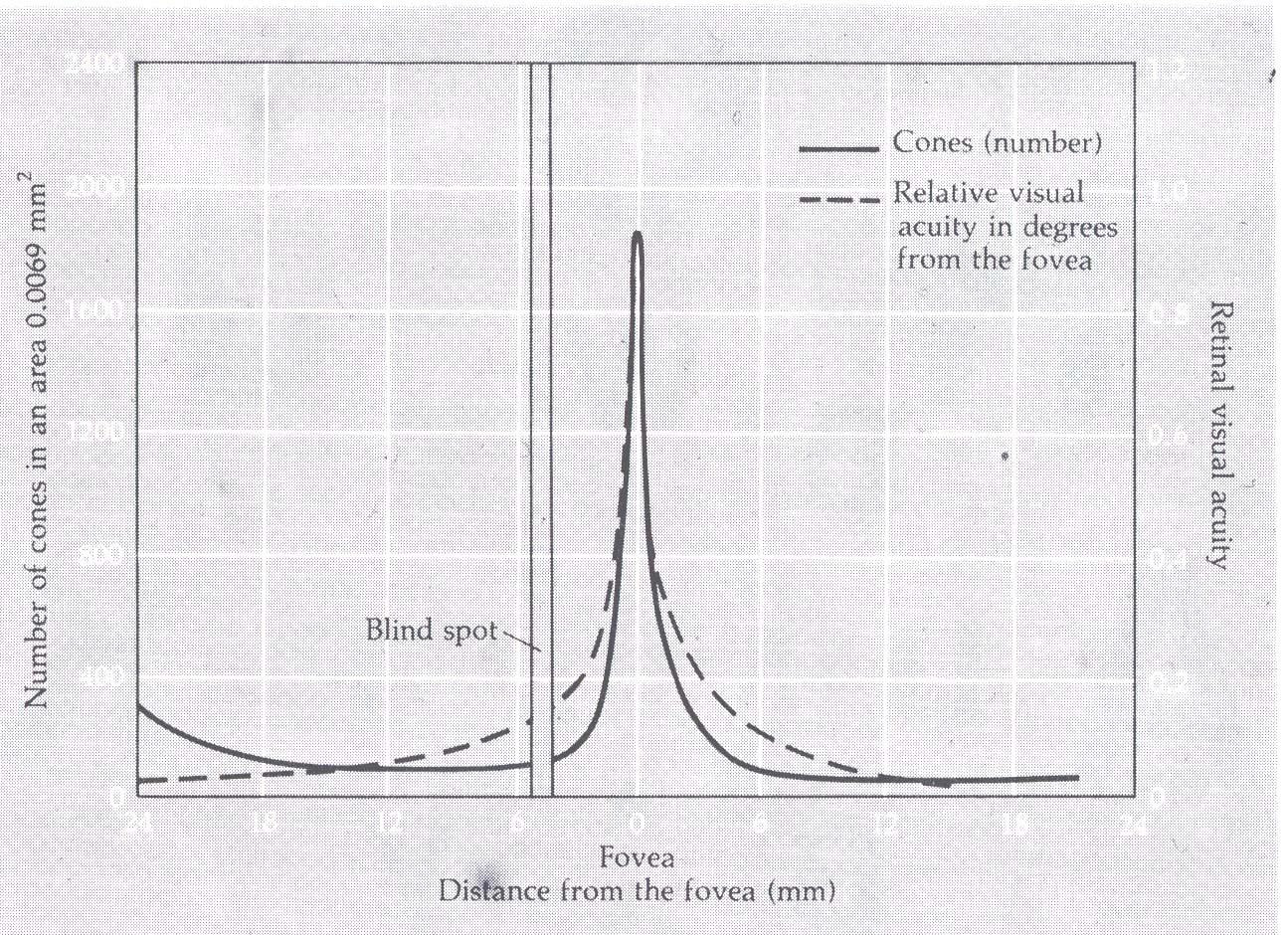
Visual Acuity matches photoreceptor density
Notes:
This is basically the same graph but also demonstrates that the level of acuity (Ie the sharpness of objects)
Is best and falls off drastically in the periphery
Peak acuity - can distinguish lines separated by a photoreceptor width.

Slide 8
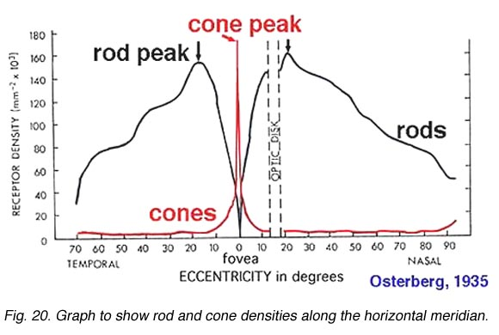
Cone Photoreceptors are densely packed in the central fovea
Notes:
120 million rods, and are more sensitive (low light) than the cones. However, they are not sensitive to color.
The 6 to 7 million cones provide the eye's color sensitivity and they are much more concentrated in fovea

Slide 9
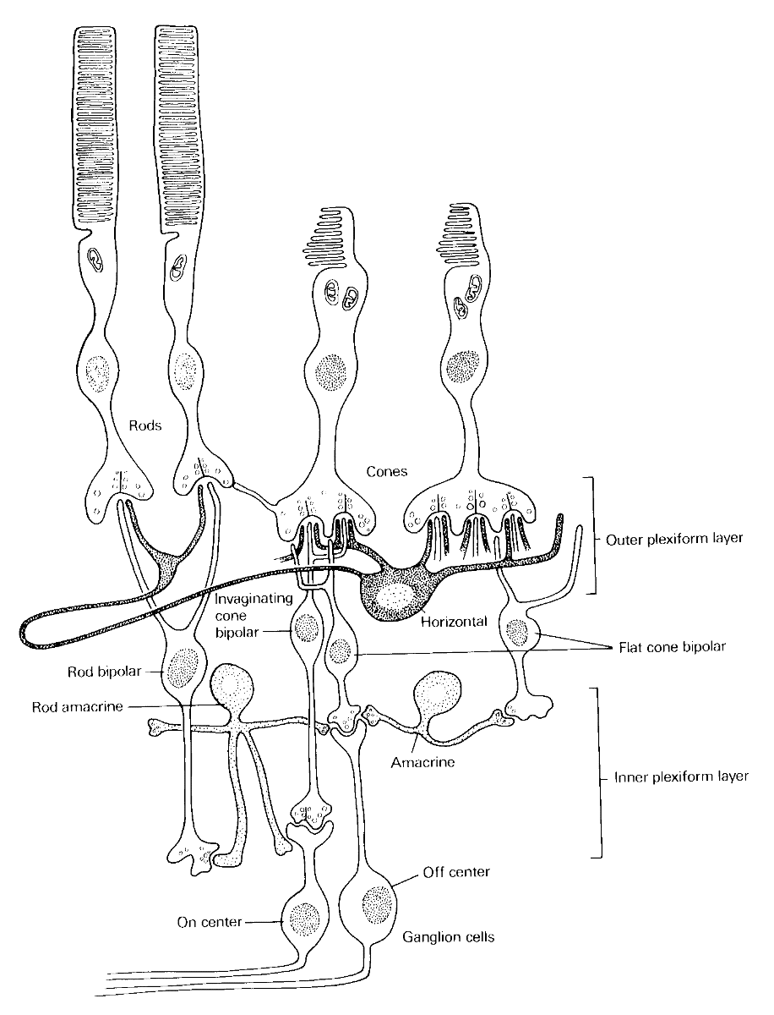
direction of light
Notes:
Rod bipolar cells synapse on AII amacrine cells which synapse on to both the on and off ganglion cells (but with opposite effect). Shown is an H1 horizontal cell the avoid S cones and connect to rods. H2 horizontal cells connect to all three cone types, especially strongly to S cones.

Slide 10
The Retinal Image: Consequences for Eye-movements

Slide 11
Retinal Model of Detection and Discrimination

Slide 12
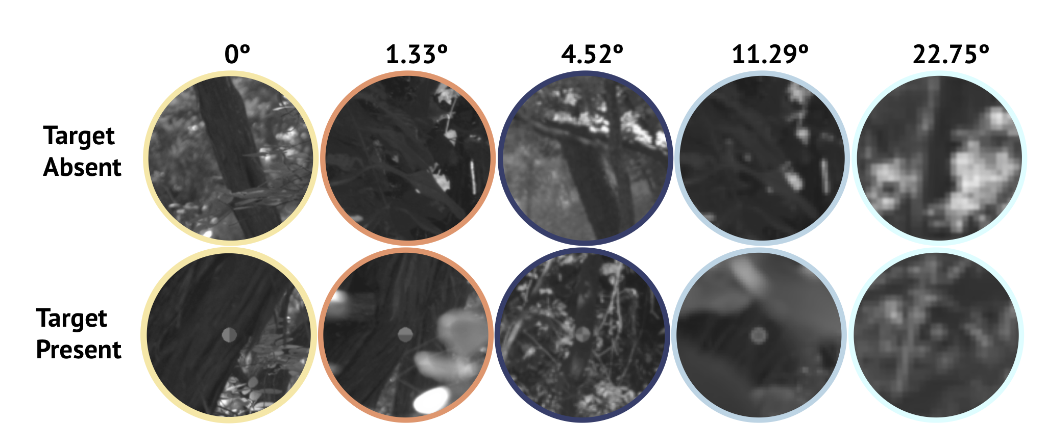

Slide 13


Slide 14
Eye movements select locations that are internally (perceptually encoded)

Slide 15
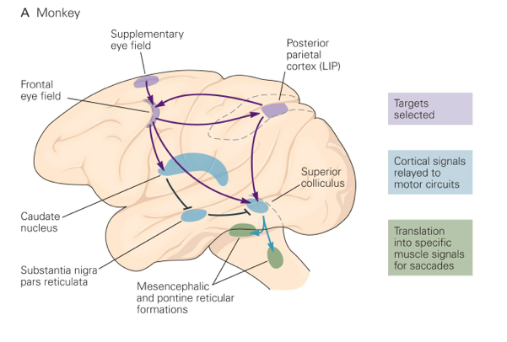
Brain Circuitry for Saccades
1. Neural activity related to saccade
2. Microstimulation generates saccade
3. Lesions impair saccade
monitor/plan movements
Dorso-lateral
pre-frontal (memory)
Basal ganglia
V
H
Oculomotor nuclei
Notes:
the frontal eye field, parietal eye field, supplementary eye field, prefrontal eye field, and area 7m
In each of these regions: (1) there is neural activity closely related to eye movements; (2) electrical microstimulation produces or modifies eye movements; (3) surgical lesions or chemical inactivation impairs eye movements; (4)

Slide 16
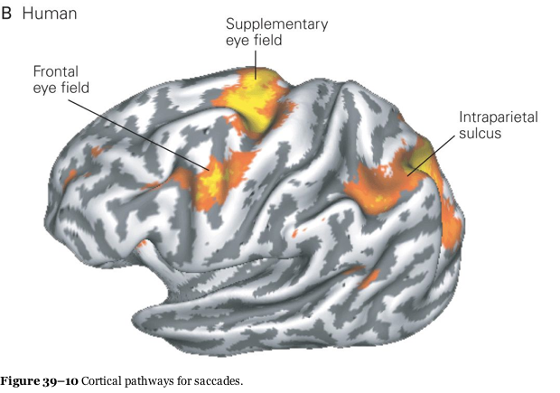

Slide 17
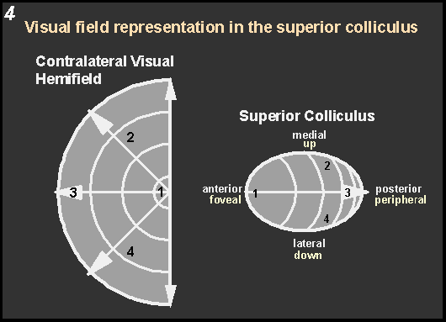
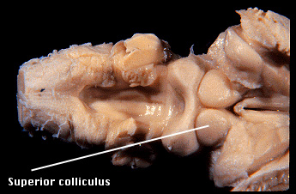
Superior colliculus
Fixation neurons
Notes:
Motor Responses
* Microstimulation produces conjugate, contralateral saccades
-- Amplitude and direction of the saccade induced depends on the site of stimulation within superior colliculus
-- Motor map - eye plus head
* Chronic recording reveals movement fields
--Neurons in intermediate and deep superior colliculus discharge maximally prior to saccades with particular amplitudes and directions.

Slide 18
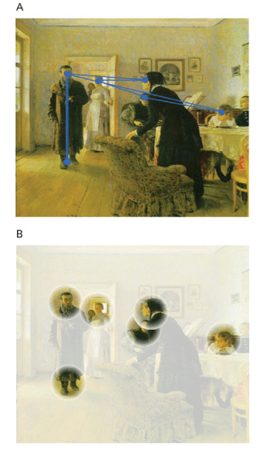
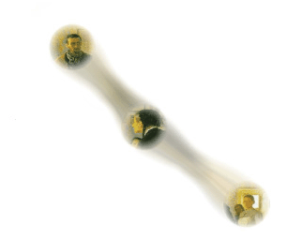
Stability
Saccades deliver a sequence of
Images to the brain that are
spatially mis-aligned.
How do we see the world as stable
and see correct direction of objects.

Slide 19
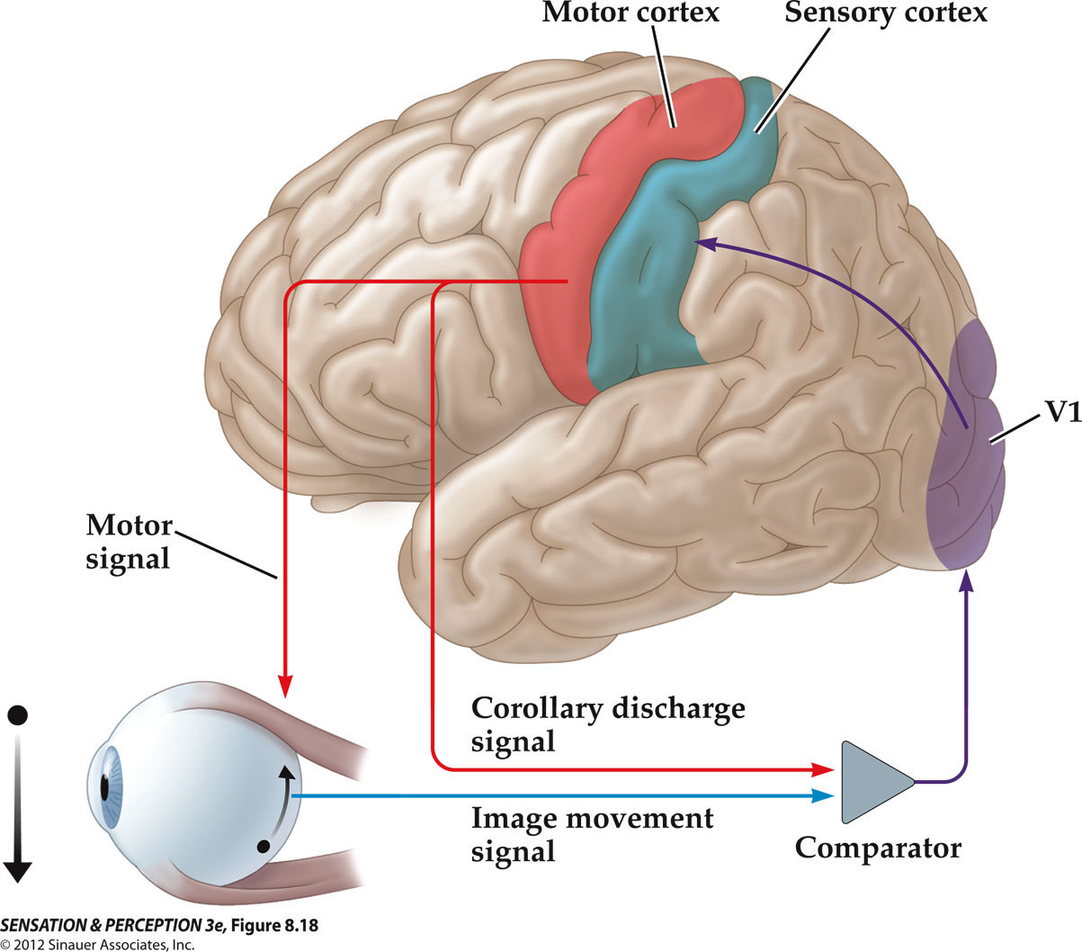
Visual Stability
Notes:
SensationPerception3e-Fig-08-18-0.jpg

Slide 20
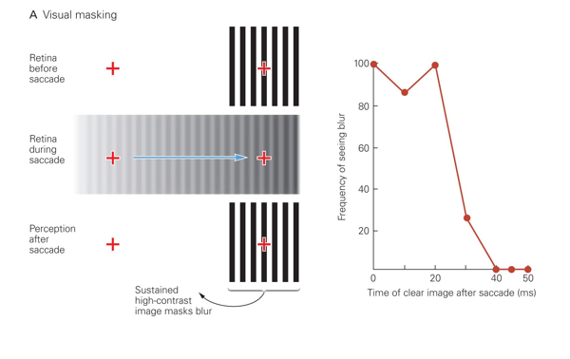
Perceptual Mechanisms and Eye movements
Visual masking also contributes to the perception of stability

Slide 21
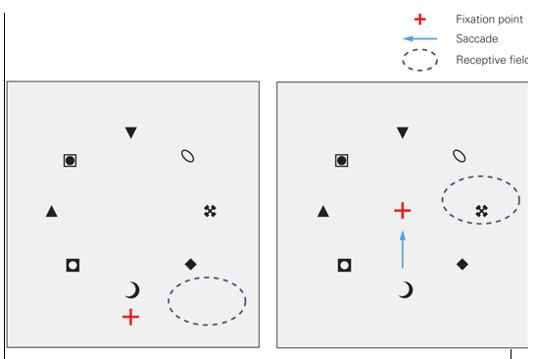
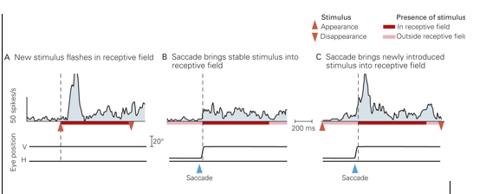
Cell responds to stimulus that will be in the RF after an eye movement,
but response begins before the movement.

Slide 22
Factors in going from perception to decision

Slide 23
What’s involved in making a saccadic eye movement?
Behavioral goal: make a sandwich – learnt sequence
Sub-goal: get peanut butter
Visual search for pb: requires memory for eg color of pb or location
Visual search provides saccade goal - attend to target location
Plan saccade to location (sensory-motor transformation)
Coordinate with hands/head (location and timing)
Calculate position signal
Execute saccade at a suitable time.

Slide 24
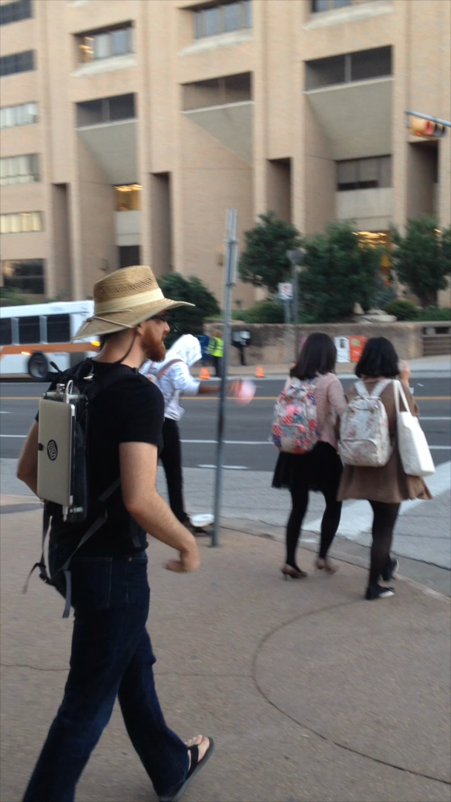
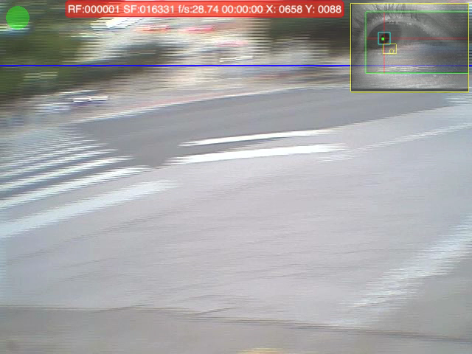
In natural behavior, humans make sequences of sensorimotor decisions that serve behavioral goals.
Notes:
Characteristic feature of human behavior is that it involves a sequences of sm decisions and these decisions serve behav goals. Here on left see a person crossing the street wearing an eye tracker. On right see the person’s gaze patterns. Image is seen from O’s POV for head mounted camera and cross hair shows where he’s looking.

Slide 25
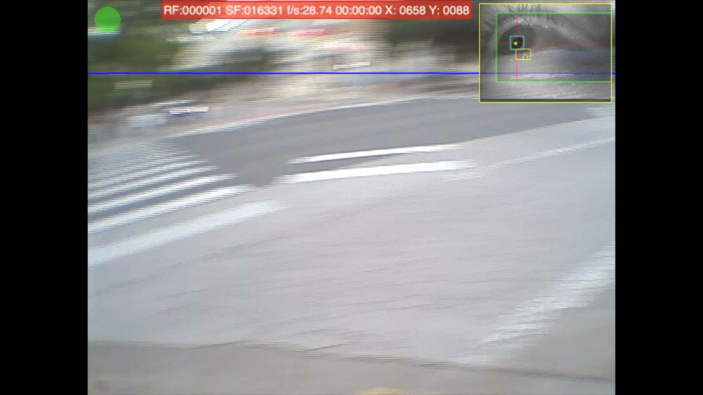
SLO-MO
Notes:
Here we see a slower version of the movie –. Issue here is what’s controlling the gaze changes? Why does gaze move from one loc to another so that the walker gets the vis info he needs at the right time?

Slide 26
Factors That Control Gaze.
- TASK Defines behavioral goals, what information is relevant.
- REWARDS Oculomotor circuitry sensitive to reward/subjective value of those goals.
- UNCERTAINTY Get information. Peripheral resolution/ working memory
REDUCTION decay etc
- PRIORS/ Memory Gaze targeting reflects stored knowledge.
- IMAGE Salient properties eg high contrast/ spatial outliers
Notes:
Many of you interested in technical challenges of eye tracking in natural behav –others in the applications to which such eye tracking can be put.
I’m going to take a step back and talk about the WHY of eye movements. Applications will depend very heavily on driving forces behind gaze control.

Slide 27
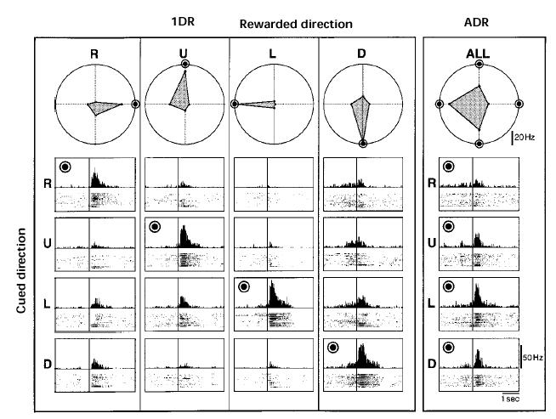
Saccade locations are related to internal rewards
Monkey makes a saccade to a stimulus - some directions are rewarded.

Slide 28
Task determines what is important: Priorities
Relation between saccades and attention.
Saccade is always preceded by an attentional shift (Kowler et al, 1995)
However, attention can be allocated covertly to the
peripheral retina without a saccade.
Thus attentional shift is necessary but not sufficient for a saccade.
Pursuit movements also require attention (Kowler, 1990).

Slide 29
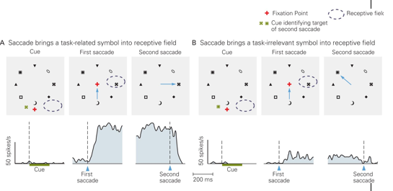
LIP cells respond to task relevant simuli

Slide 30
Putting it all together with models

Slide 31
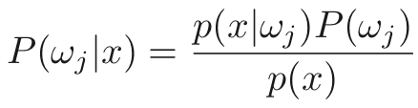
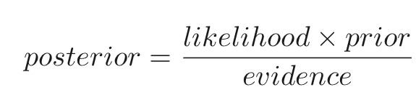
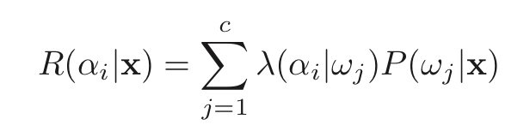
Some preliminaries
Bayes Rule
Risk/Utility

Slide 32
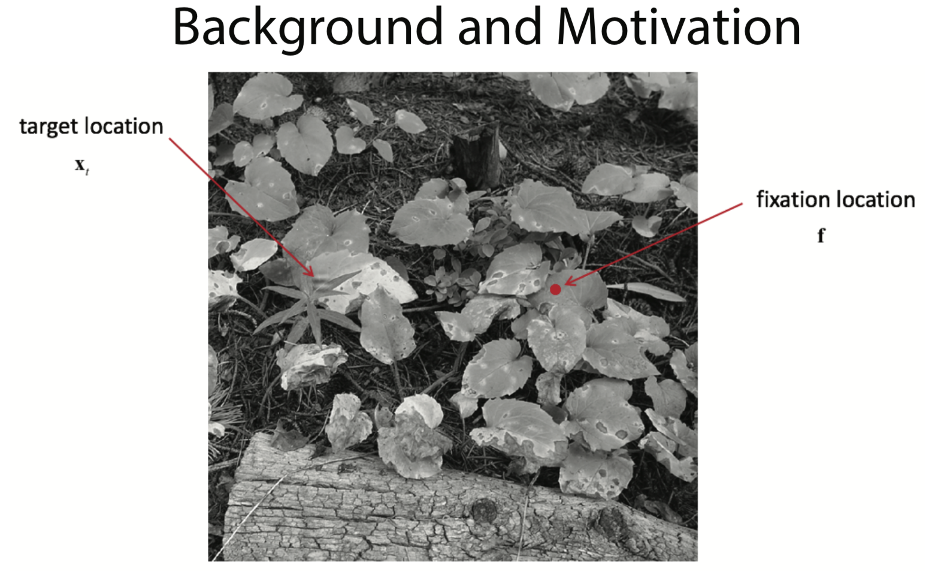
Search

Slide 33
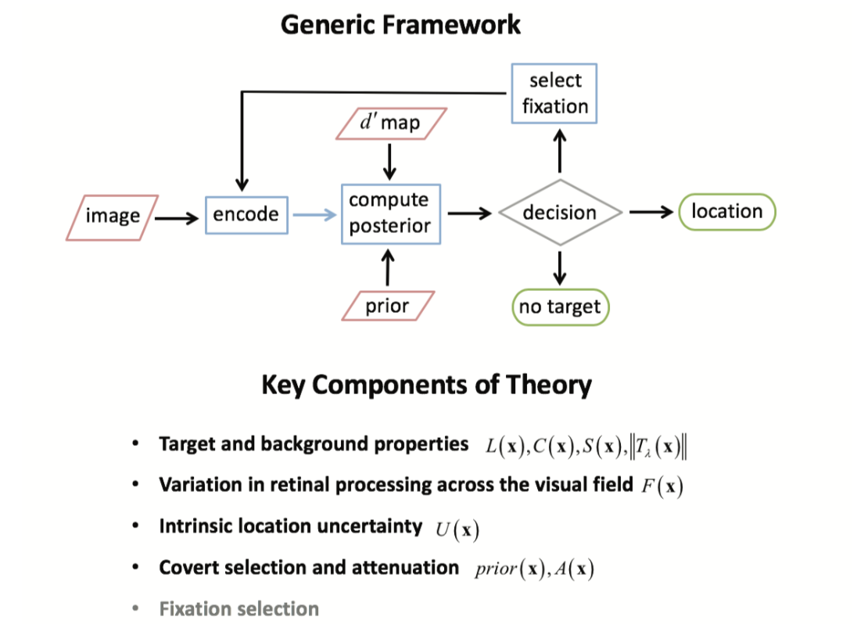

Slide 34
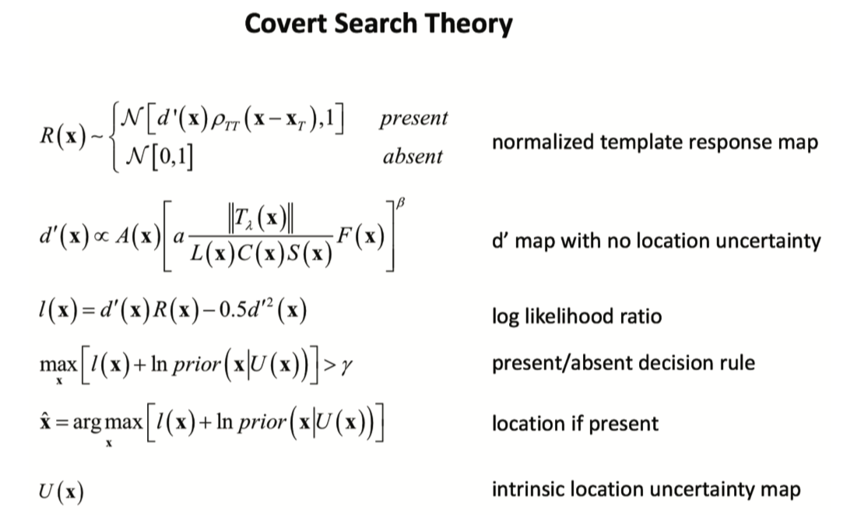

Slide 35
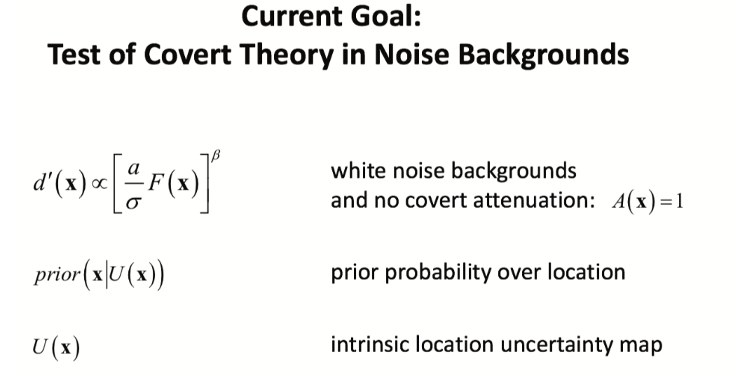

Slide 36
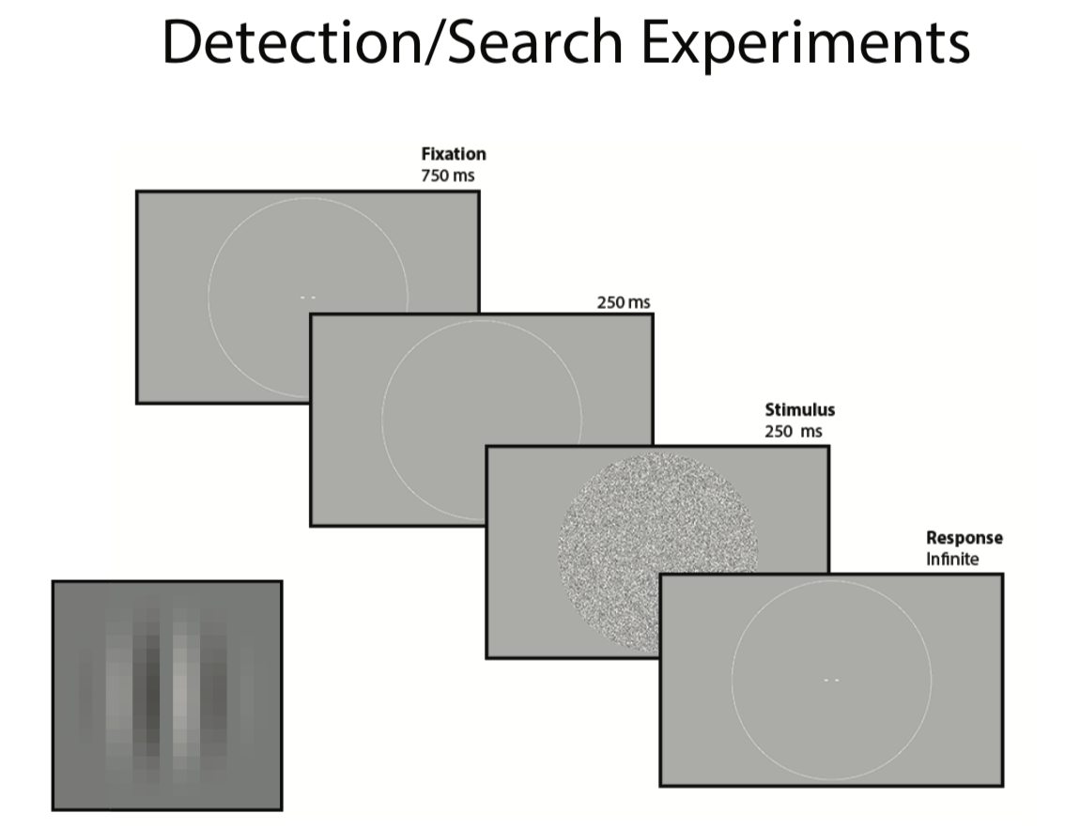

Slide 38
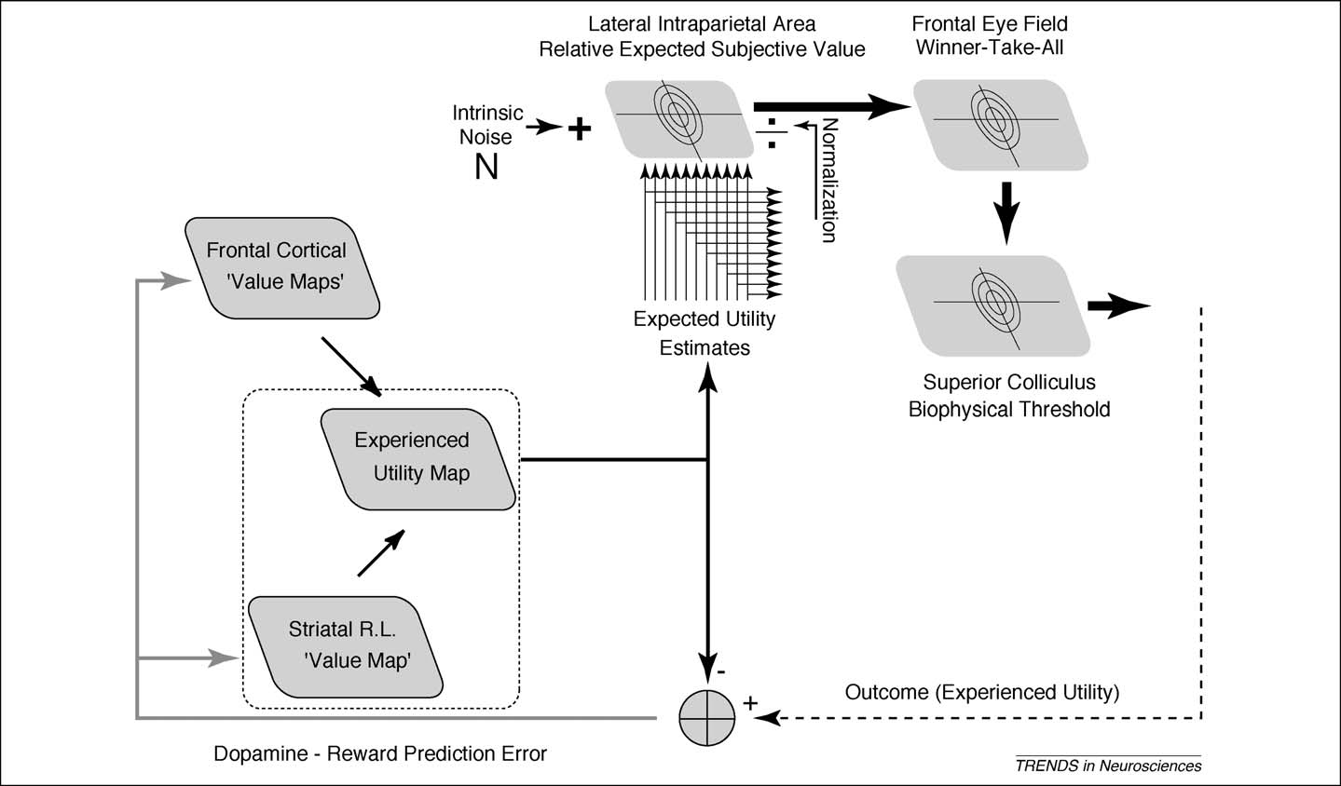
Subjective Value (reward, expectation, memory etc…)
Trommershauser, Glimcher, Gegenfurtner, 2009

Slide 40
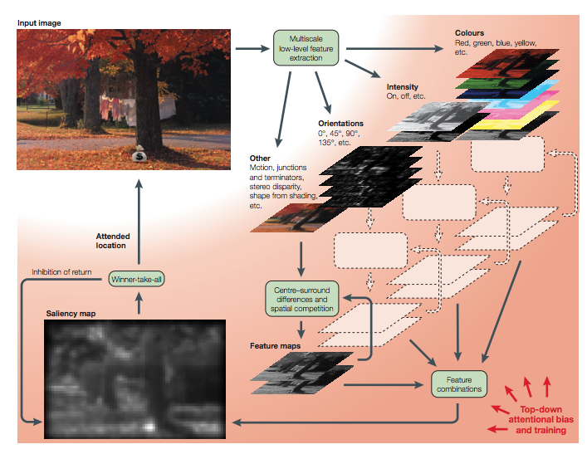
Salience

